Slide 1
Acute rejection
Acute rejection rates have steadily declined from nearly 100% in the first era of organ transplantation to approximately 10% more recently
T-cell mediated = Steroid responsive= pre transplant donor-specific antibodies (DSA) = lymphocytic infiltrate of tubules (tubulitis) and larger vessels (vasculitis).
Ab mediated = Steroid non responsive = HLA A/B/DR mismatch (1) active tissue injury,
(2) immuno-histologic evidence of peritubular capillary complement split-product C4d deposition
(3) circulating DSA

Slide 2
Risk Factors of Rejection
Positive panel reactive antibody test ?
Repeat transplant?
Black race
Recipient age
Immunosuppression regimen and exposure

Slide 3
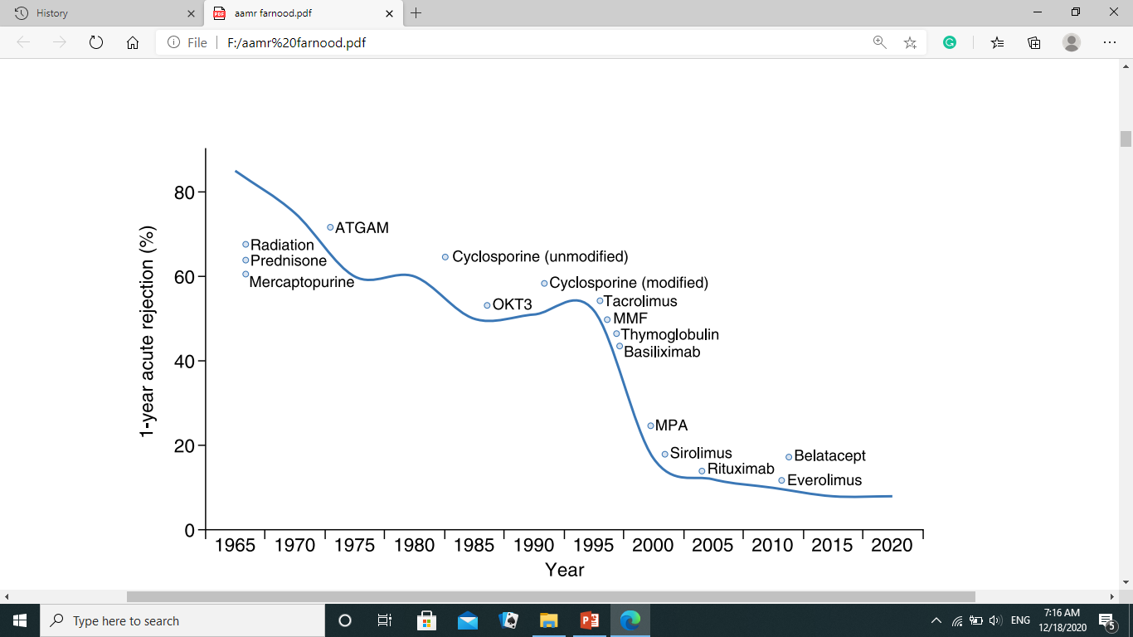
Am J Transplant 17[Suppl 1]: 21–116, 2017

Slide 4
Acute T cell–mediated rejection (TCR)
Banff 2017 guidelines:
Ia :>25% Interstitial inflammation with moderate tubulitis (t2)
Ib :>25% Interstitial inflammation with severe tubulitis (t3)
IIa Mild-to-moderate intimal arteritis (v1)
IIb Severe intimal arteritis (v2)
III Transmural arteritis and/or fibrinoid necrosis

Slide 5
Acute antibody-mediated rejection (AMR):
All three criteria below required (Banff 2017 guidelines)
A-Histologic evidence of tissue injury including one or more of the following:
1- Microvascular inflammation
2- Arteritis
3- Thrombotic microangiopathy
4- Acute tubular injury
B- Evidence of current/recent Ab interaction with endothelium including 1 or more of the following:
1- Positive C4d staining of peritubular capillaries
2- Moderate microvascular inflammation
3- Increased expression of gene transcripts in biopsy tissue strongly associated with AMR
C-Serologic evidence of donor-specific antibodies (DSA)
1- Positive C4d staining or presence of AMR-associated gene transcripts may substitute for DSA

Slide 6
The revised 2013 Banff criteria for antibody mediated rejection diagnosis removed the requirement for C4d detection
Recent Banff consensus notes studies removed the requirement for documented circulating DSA in the setting of positive C4d staining and microvascular inflammation. Am J Transplant 18: 293–307, 2018

Slide 7
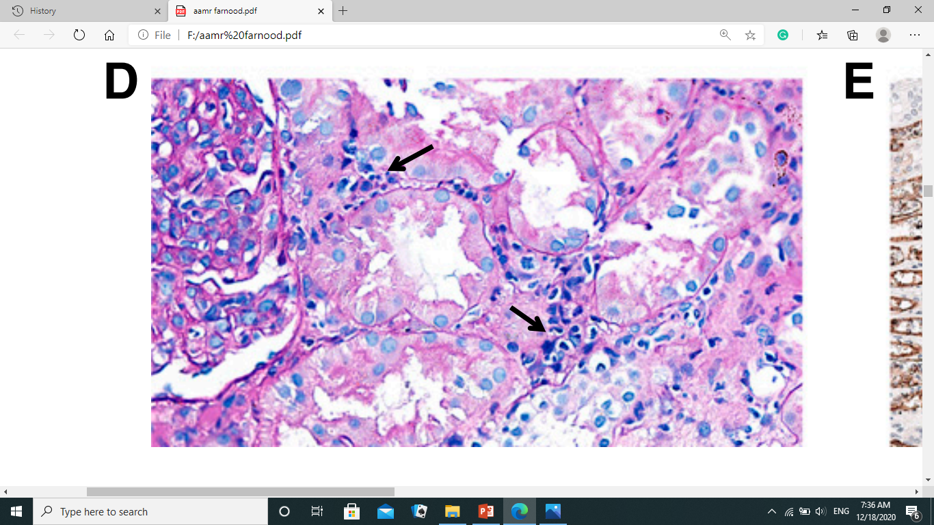
Peritubular lymphocytic infiltration

Slide 8
Acute Rejection Diagnosis
The gold standard for diagnosing acute rejection in kidney transplant recipients is tissue biopsy.
It should be pursued without delay in patients with graft dysfunction that is not explained by other nonimmunologic causes

Slide 9
Diagnosis
Numerous studies of urine and blood biomarkers, such as CXCL9, CXCL10, granzyme B, perforin, and Fas ligand, have generally shown mixed sensitivity and specificity for identifying acute rejection, differentiating T cell–mediated rejection from antibody-mediated rejection, and distinguishing immunologic injury from other forms of graft damage
Decreased urinary miR-210 levels have been associated with T cell–mediated rejection and subsequent 1-year GFR decline
Donor-derived cellfree DNA (cf-DNA) profiling has been applied to the noninvasive diagnosis of antibody-mediated rejection

Slide 10
Acute Rejection Treatment
Treatment strategies differ between T cell–mediated rejection and antibody-mediated rejection
Any untreated clinical acute rejection episode will ultimately result in accelerated graft loss.

Slide 11
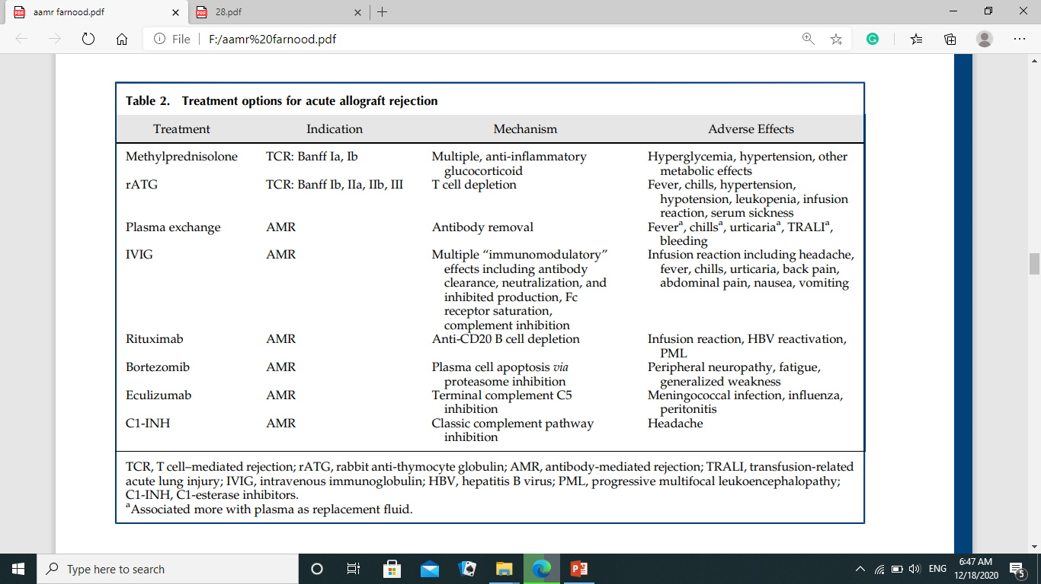

Slide 12
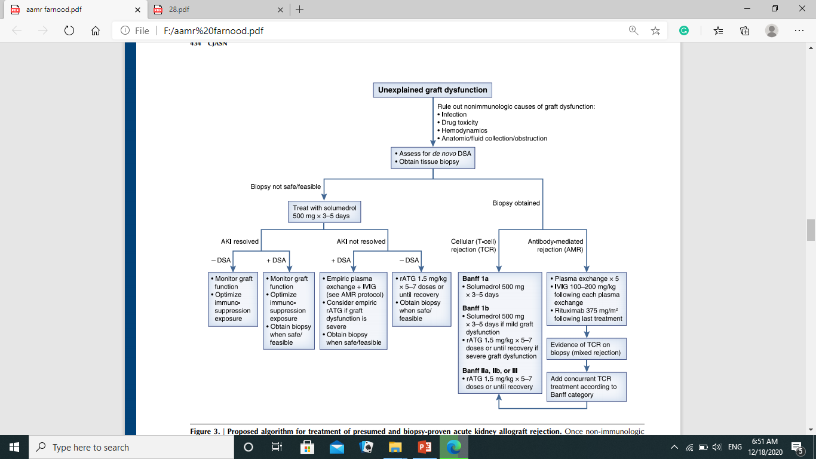

Slide 13
Antibodymediated rejection treatments
Removing antibody-producing B cells or plasma cells
Removing antibodies (DSA)
Inhibiting the subsequent complement-regulated graft damage

Slide 14
Antibodymediated rejection treatments
Plasma exchange and intravenous Ig (IVIG), with or without rituximab, was the most commonly used strategy and is generally considered standard of care for antibody-mediated rejection treatment
Daily or every other day plasma exchange consisting of 1.5 plasma volume removal with each treatment followed by IVIG at 100–200 mg/kg, with or without a single dose of rituximab at 3.75 mg/m2. Transplantation 102: 557–568, 2018
Treatment regimen consisting only of IVIG is inadequate for most cases

Slide 15
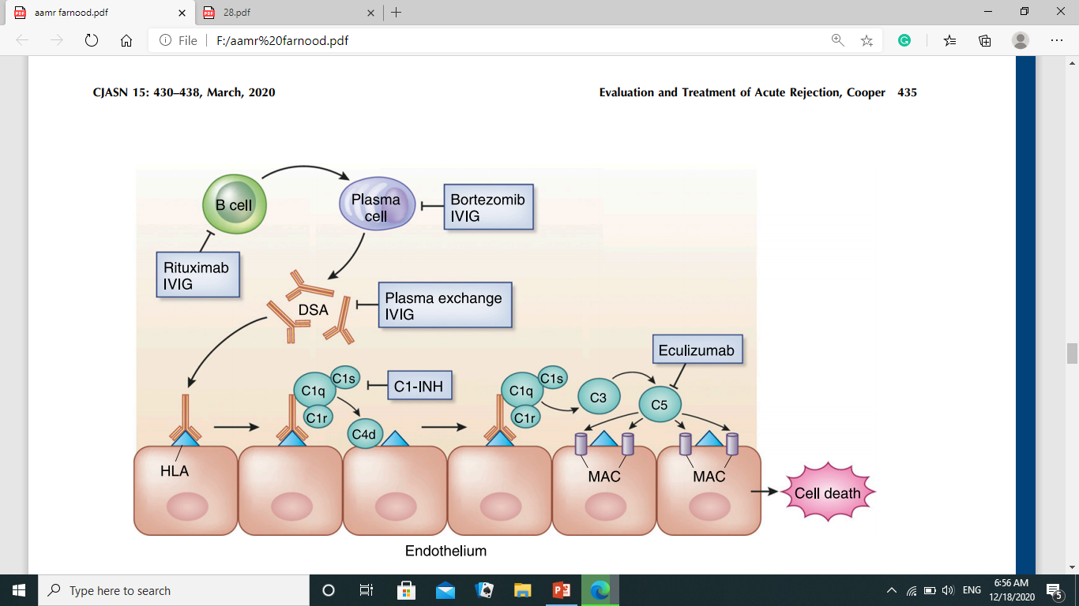

Slide 16
T cell–mediated rejection involving lymphocytic infiltrate of the vasculature (Banff II and III lesions) generally requires T cell–depleting therapy, most commonly rATG.
Antibody therapy was superior to steroid therapy in reversing T cell–mediated rejection.

Slide 17
Antibody-Mediated Rejection
Several new therapeutic treatment options have been studied in recent years.
Treatments are directed at:
removing antibody-producing B cells or plasma cells
removing antibodies (DSA)
inhibiting the subsequent complement-regulated graft damage

Slide 18
Antibody-Mediated Rejection
Plasma exchange and intravenous Ig (IVIG),with or without rituximab, was the most commonly used strategy and is generally considered standard of care for antibody-mediated rejection treatment (CJASN 15: 430–438, March, 2020 )
Daily or every other day plasma exchange consisting of 1.5 plasma volume removal with each treatment followed by IVIG at 100–200 mg/kg, with or without a single dose of rituximab at 3.75 mg/m2.

Slide 19
Refractory Antibody-Mediated Rejection
1-Bortezomib, a proteasome inhibitor for treatment of multiple myeloma, has received special focus because of its ability to induce apoptosis in antibody-producing plasma cells.
There is minimal effect on DSA burden when used as a sole agent.
2- The humanized mAb eculizumab has been targeted in the prevention and treatment of antibody-mediated injury because of its mechanism of complement component C5 inhibition.
Patients treated with combination splenectomy and eculizumab experienced no graft loss and minimal transplant glomerulopathy on protocol biopsy.

Slide 20
3-A pilot study of the anti-IL 6 receptor antibody tocilizumab has shown promising results for patients with chronic antibody-mediated rejection (Am J Transplant17:2381–2389, 2017)
4- C1-esterase inhibitors (C1-INH) have recently used for the treatment of acute antibody-mediated rejection .
C1-INH inhibits proximal enzymes in the classic complement pathway including C1q.

Slide 21
There is significant reduction in acute rejection in patients treated with belatacept by adding tacrolimus. Adams et al. Am J Transplant 17: 2922–2936, 2017

